Slide 1
Petrache Poenaru and his Magic Pump
Project Realised by: Mihai Claudiu

Slide 2
Petrache Poenaru and his Magic Pump
1. Who was Petrache Poenaru?
2. Why did you do a presentation about him?
3. What is this Magic Pump?
4. Why include it in this presentation?

Slide 3
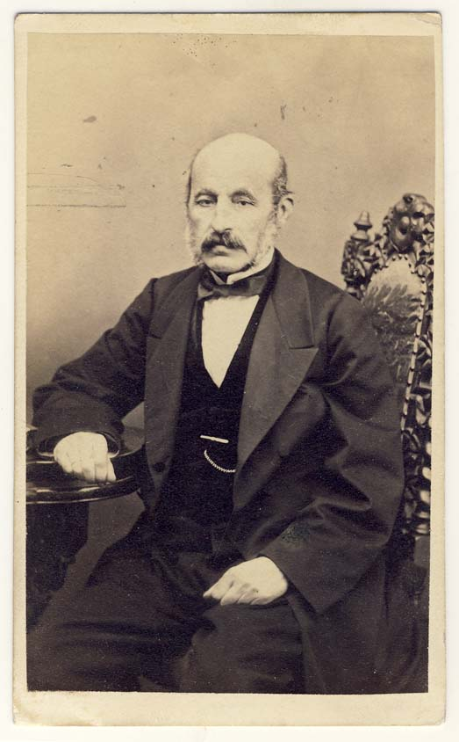
1. Who was Petrache Poenaru?
A mathematician
A physicist
An engineer
An inventor
A teacher
Organizer of the educational system
A politician
An agronomist
A zoo technologist
The founder of Philharmonic Society
Founder of Botanical Gardens
Founder of National Museum of Antiquities in Bucharest

Slide 4
2. Why did you do a presentation about him?
&
3. What is this “Magic Pump”?
While being a student in Paris, Petrache Poenaru invented the world's first fountain pen, an invention for which the French Government issued a patent on May 25, 1827.

Slide 5
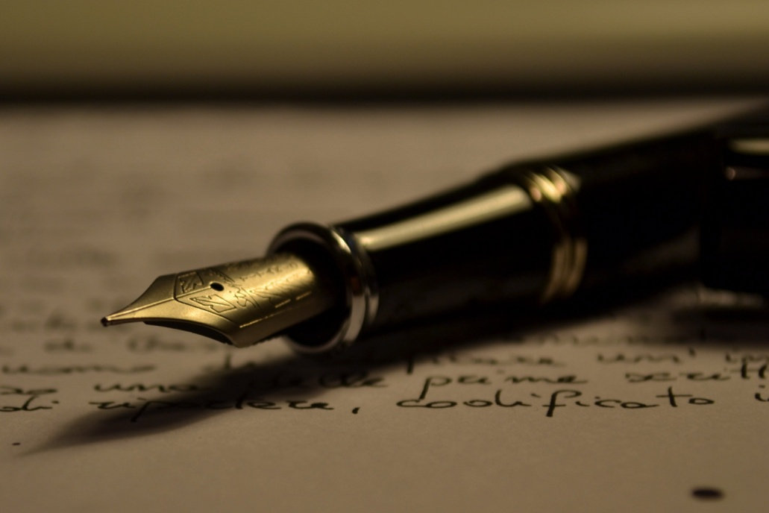
4. Why include it (the “Magic Pump”) in this presentation?
It was the first writing instrument that:
Held ink in a reservoir and delivered it to the nib
Would not stain his hands or clothes of the user
Which could be held upside-down without leaking

Slide 6
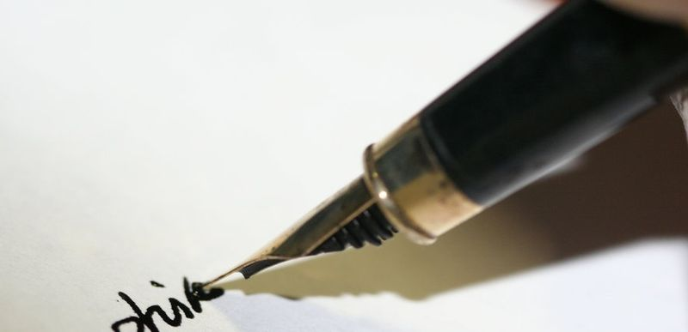
The fountain pen holds its ink in a internal reservoir which is drawn through a feed to the nib by way of gravity and capillary action.
The fountain pen requires little to no pressure to write.
After three key inventions happened in the 1850′s the fountain pen finally become popular as a writing instrument.

Slide 7
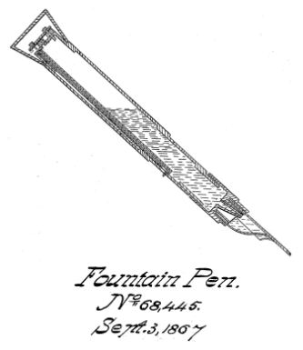
A little bit more about the previous “versions” :
The earliest historical record of a reservoir pen dates to the 10th century.
In Deliciae Physico-Mathematicae (a 1636 magazine), German inventor Daniel Schwenter described a pen made from two quills.
In 1828 Josiah Mason improved a cheap, efficient slip-in nib in Birmingham, England, which could be added to a fountain pen and in 1830, with the invention of a new machine, William Joseph Gillott, William Mitchell and James Stephen Perry devised a way to mass manufacture robust, cheap steel pen nibs.

Slide 8
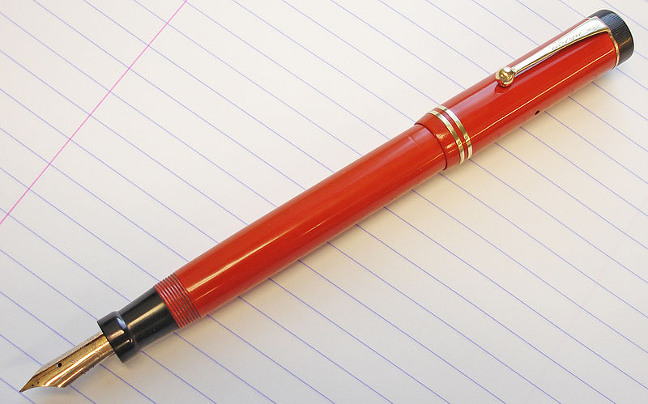
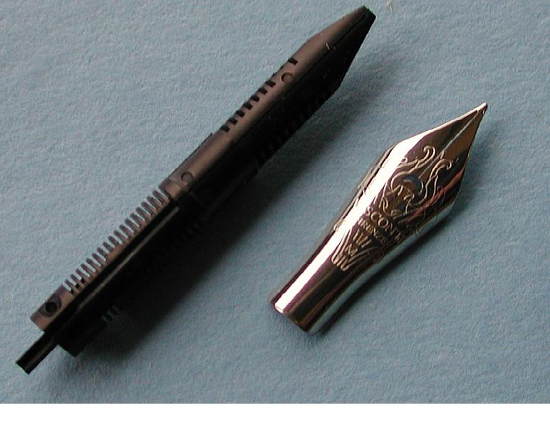
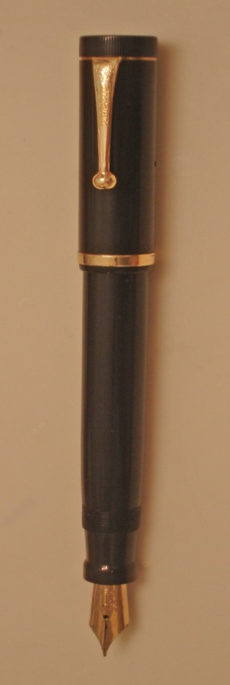
Petrache Poenaru’s
influence
Progress in developing a reliable pen was slow until the mid-19th century when the Romanian inventor Petrache Poenaru received a French patent for the invention of the first fountain pen with a replaceable ink cartridge.

Slide 9
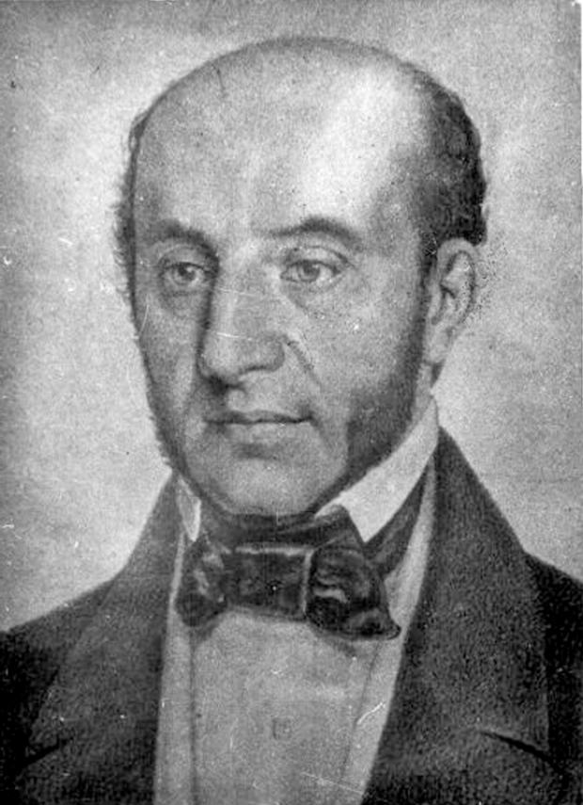
A few more things about
Petrache Poenaru:
Birth and youth:
He was born in 1799 in Băneşti, Vâlcea County. Poenaru attended the secondary school Obedeanu in Craiova and worked as a copyist at the office of the bishop of Râmnicu Vâlcea. Later on, between 1820 and 1821, he taught Greek language at the Metropolitan School in Bucharest.

Slide 10
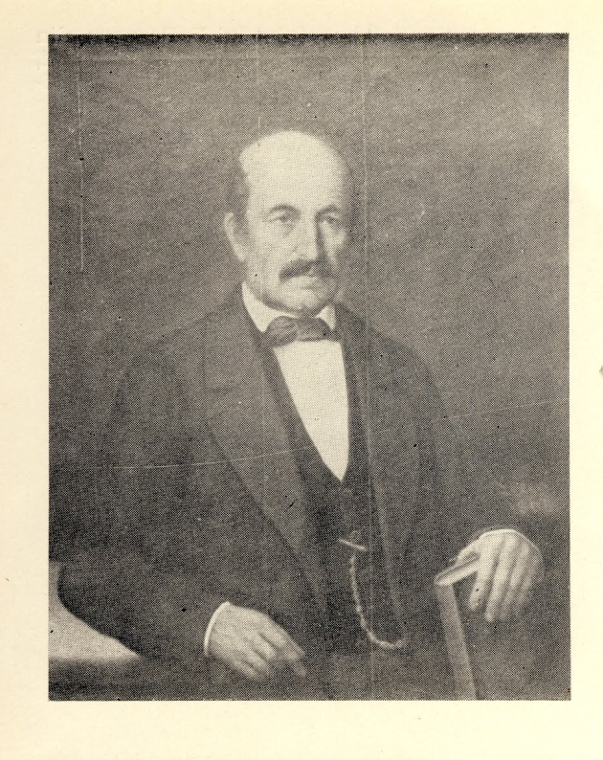
Conclusions:
Petrache Poenaru :
Born: January 10, 1799 Băneşti, Wallachia
Died: October 2, 1875 (aged 76)
Nationality: Wallachian, Romanian
Occupation: Inventor, mathematician, physicist, teacher, politician
Known for: Inventing the fountain pen

Slide 11
Project Realised by: Mihai Claudiu
Senchea High School
From
Fagaras

